Slide 1
Custom components - basics
Encapsulated, single-responsibility, reusable code

Slide 2

Contents
What is a web component?
What is a custom web component?
How do recognize a web custom component?

Slide 3
What is a web component?
Web Components is a suite of different technologies allowing you to create reusable custom elements — with their functionality encapsulated away from the rest of your code — and utilize them in your web apps.

Slide 4
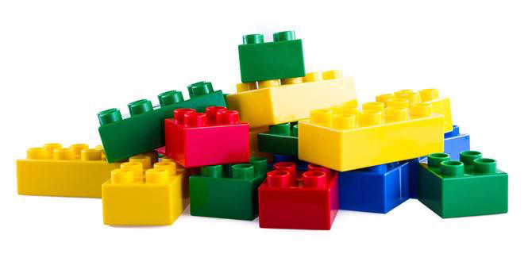
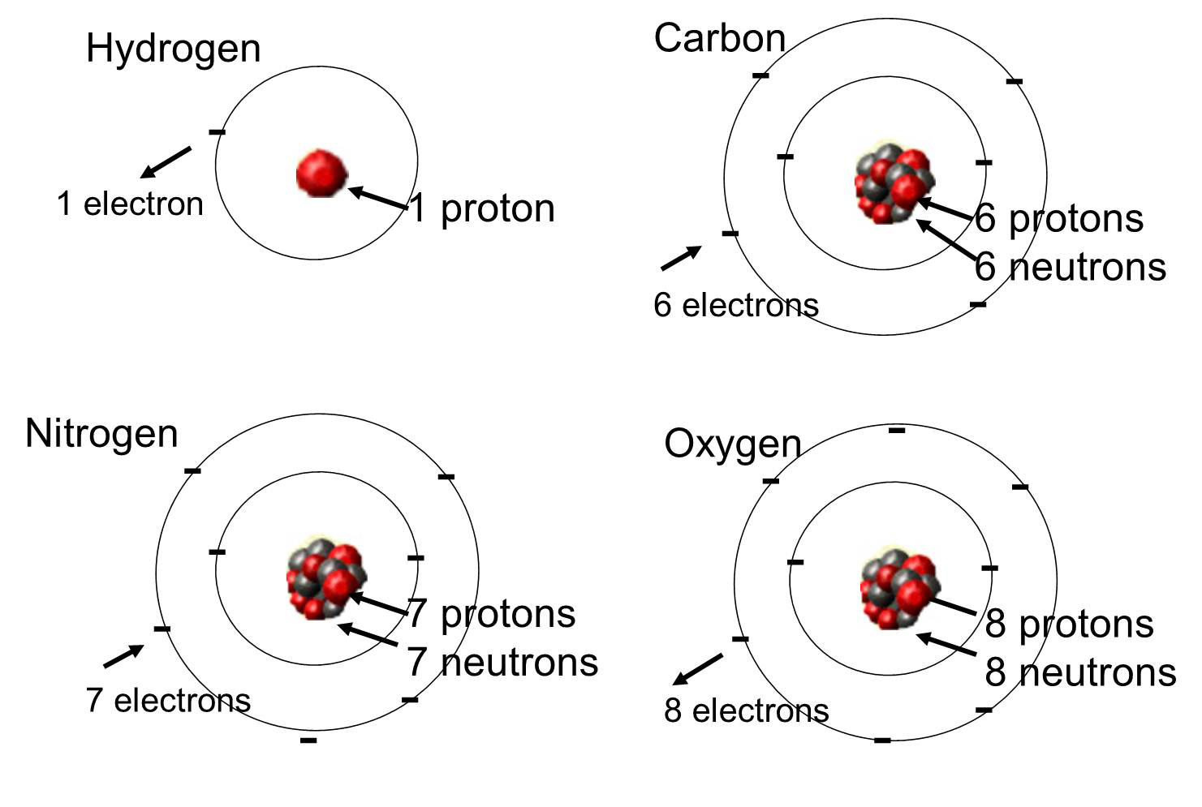
Modularisation
Most things we create consist of a combination of smaller parts (modules)
A house consists of bricks, frames, walls and floors
Music consists of melodies, harmonies, verses and choruses
Each part has specific features, functionality comes from the combinations and interactions.

Slide 5
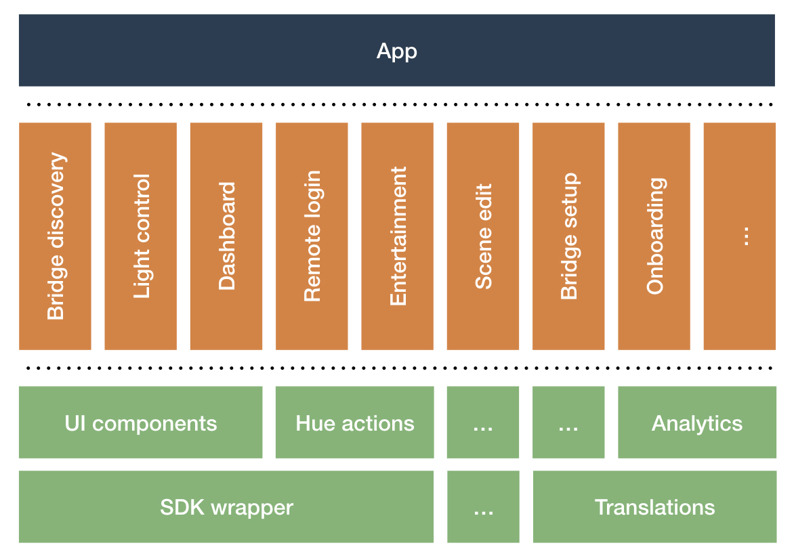
Modularisation in software
In software development modularisation is a key aspect of writing good code
Divide the solution into small parts that each have a set of specific features
This supports for example; re-usability, maintainability
Examples:
(Java) classes (OOP in general), code organisation in files and folders, etc

Slide 6
Web app code issues
No clear separation of concerns
Prior to web components code could be:
Disorganised
Repetitive
Fragile
No obvious way to reuse code
Small changes potentially break the whole app

Slide 7
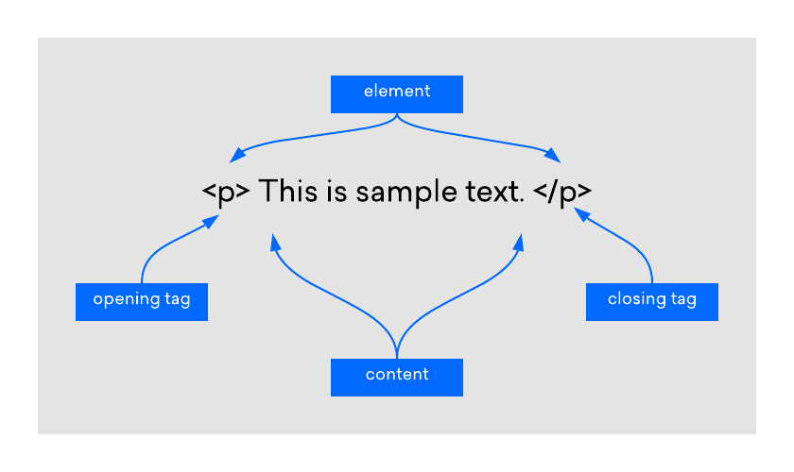
Web Component
The HTML language is a set of components that are identified as tags:
<component></component)
For example
<p>, <input>, <h1>, <body>, <ul>, <li>
Each component has a specific set of features, functionality comes from the combinations and interactions
Introduced in FEP1

Slide 8
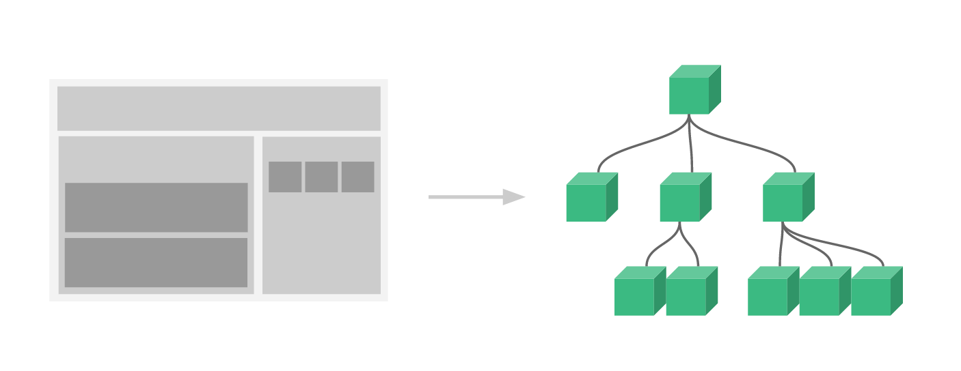
Web Component
Each element on an html page
Has a representation in the DOM

Slide 9
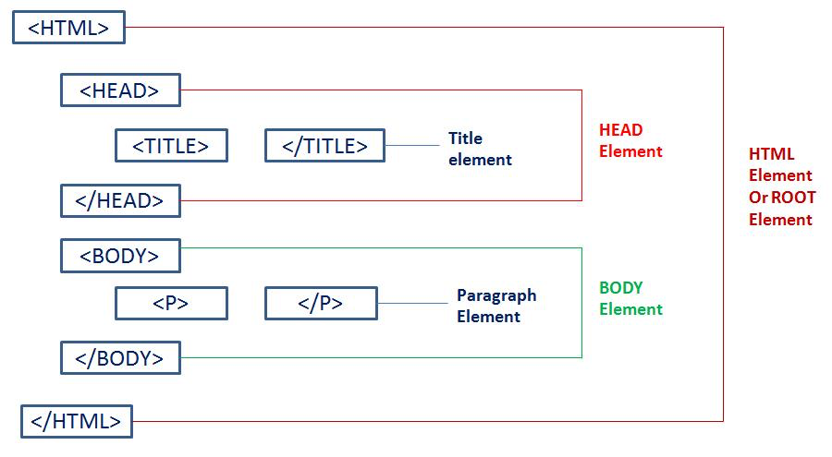
Web component
Web components are nothing new, you’ve worked with them before
The implementation (code) that maks the components work is hidden (encapsulation)
Wouldn’t it be great if we could develop additional components ourselves.

Slide 10
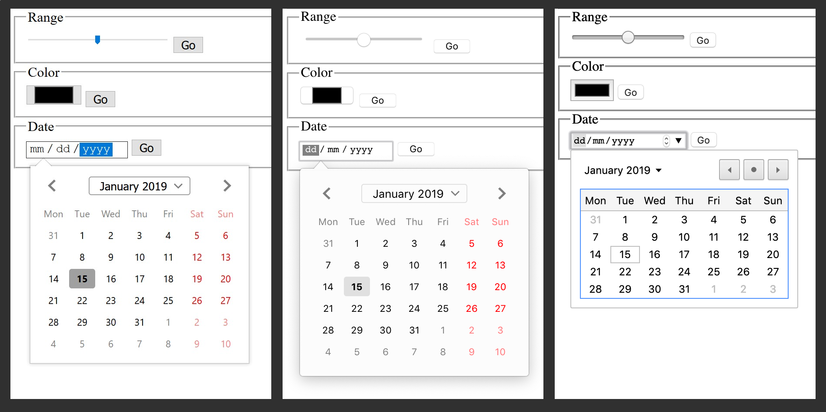
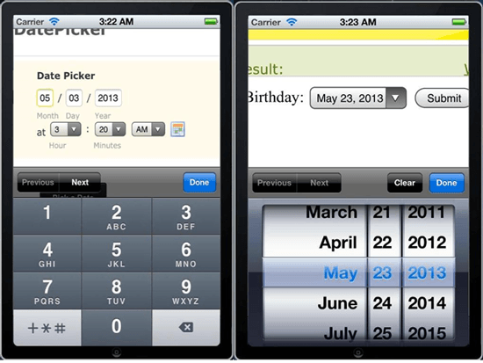
Example: <input type=“date”>
The input of type date looks different in various browsers and OS-es.

Slide 11
Recognise web components
Web components are (mostly) visual elements
You should be able to recognise them
A few examples

Slide 12
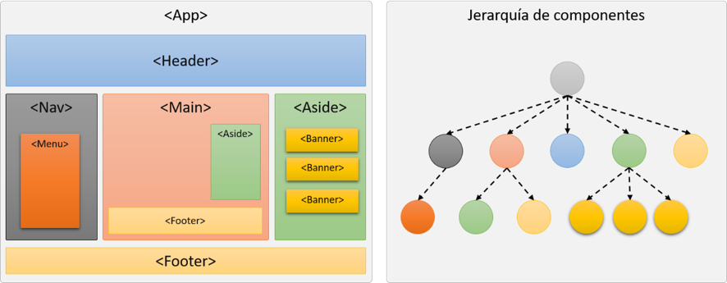
Remember this?
Possible web component?

Slide 13
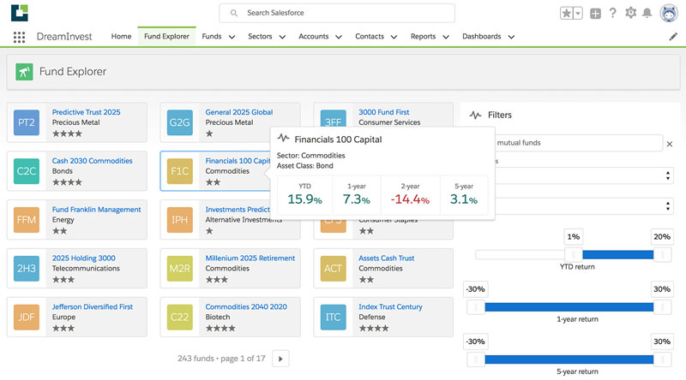
Spot the web components
Here’s one
And another
Also…
This?
Yes! web components in web components.
Also…
And another

Slide 14
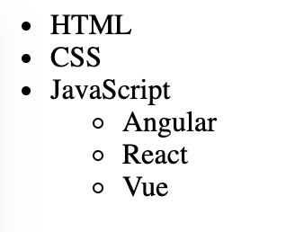
Web component nesting
En dat kan dus ook met custom components
Dit kennen jullie al; nested lists
<ul><!-- start of main list-->
<li>HTML</li>
<li>CSS</li>
<li>JavaScript
<ul><!-- start of nested list-->
<li>Angular</li> <li>React</li>
<li>Vue</li>
</ul><!--end of nested list-->
</li>
</ul><!--end of main list -->

Slide 15
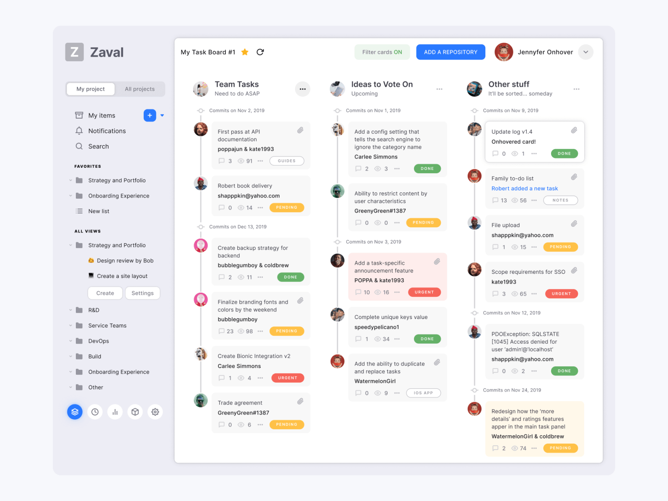
List with elements
(Custom component)
Single element
(Custom component)
Visual element
(Custom component)
Visual element
(Custom component)

Slide 16
Code example nested components
List with elements
(Custom component)
<my-customlist>
<my-customelement>
<my-customview>
</my-customview>
</ my-customelement >
</my-customlist>
Single element
(Custom component)
Visual element
(Custom component)

Slide 17
What is a custom web component?
Custom web components are web components a developer can create and use just like regular web components

Slide 18
What is a custom web component?
A javascript class that:
extends the class HTMLElement
implements behaviour
defines a html tag string
It can be (re) used in any html application

Slide 19
What is a custom web component?
So it is like a Angular, React, Vue component?
No!
Angular (and React and Vue) components depend on their framework and cannot be re-used outside it.
But it does serve the same purpose!

Slide 20
Conclusion
Custom web components are created using a javascipt class that extends HTMLElement
Custom web component behave just like regular web components (elements)
You can nest (custom) components
You can layout your app using custom components

